Slide 1

Basic Details of the Team and Problem Statement
Ministry/Organization Name/Student Innovation: Ministry of
PS Code: SIH1433
Problem Statement Title: Mental health and well-being surveillance, assessment and tracking solution among children
Team Name: NeuroNinjas
Team Leader Name: Sagnik Chakraborty
Institute Code (AISHE):
Institute Name:Techno International Batanagar
Theme Name: Smart Education
Education

Slide 2
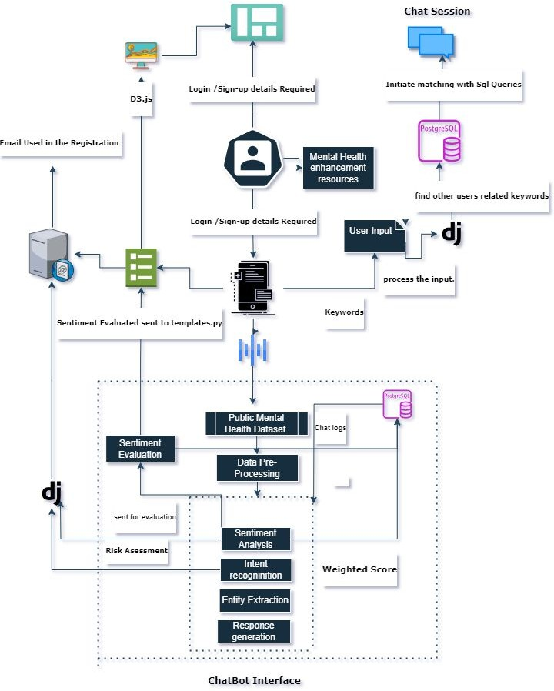
SYSTEM DESIGN:

Slide 3
Idea and Approach Details
 | DESCRIPTION OF OUR SOLUTION:
Mental Health Awareness Section:
Helps one eliminate the stigma and raises awareness on various mental health issues.
Real-time Notifications:
Immediate alerts sent to local Mental Health Support services upon detecting severe mental distress signs.
Utilizes SMTP technology for delivering immediate alerts to the authorities.
Community Support:
Provides a safe space for children to interact and share their feelings with peers.
Offers real-time bidirectional communication for instant chatting.
Allows children to enter keywords based on their feelings or interests in a monitored environment.
Mental Wellness Library:
Curated collection of mental wellness exercises, yoga routines, and meditation practices designed for children.
Kids can explore, practice daily, and add favorite routines to a wishlist for easy access.
Core Concept:
Utilizes state-of-the-art NLP & ML techniques for analyzing children's interactions and extracting sentiments.
Personalized Interaction:
Chatbot tailored for children to understand and respond to their unique emotional needs.
Advanced Sentiment Analysis:
Utilizes the BERT pre-trained model fine-tuned for specific sentiment analysis tasks.
Captures subtle hints of children's emotional states in their expressions.
MH Check Dashboard:
Equips users with a weekly report of their mental health status to better understand their emotional well being.

Slide 4














Idea and Approach Details
 | TECHNOLOGY STACK:

Slide 5
Idea and Approach Details
DEPENDANCIES:
Data Quality & Volume:
Accurate sentiment analysis relies on diverse and high-quality data from various child age groups.
The prototype shows promise and with more real-world data the accuracy can be enhanced.
Tech Infrastructure Stability:
The platform depends on stable cloud infrastructure for real-time notifications and responses.
Downtime or lag can hinder crucial alerts and reduce the effectiveness of the service.
Regulatory Compliance:
Adherence to child data protection regulations is mandatory and ethically important.
Any oversight in compliance could lead to legal consequences.
Market Acceptance & Education:
Adoption of the platform relies on raising awareness about children's mental health.
Sales and marketing efforts should not only promote the product but also educate potential clients on the importance of the issue.
Integration with Educational Institutions:
Integrating the platform into schools, a significant user base, presents technological and sales challenges.
Seamless integration with existing educational systems is essential.

Slide 6
Idea and Approach Details
Daily mental wellness exercises and resources:
Users: Children & Parents
Perspective: Provides tools for self-improvement, building resilience and emotional intelligence in kids.
□ The system's multi-faceted approach, spanning AI-driven
sentiment analysis to real-time parental notifications, fills a significant market gap by offering proactive mental health solutions tailored for the young demographic.
□ The community-building aspect has the potential to foster brand
loyalty, as users not only find solace in the platform's features but also in connections they establish with peers.
USE CASES:
AI chatbot :
Users: Children
Perspective: Provides an immediate, non-judgmental avenue for kids to voice their emotions, ensuring they don't feel alone.
Weekly Sentiment Analysis Report :
Users: Children
Perspective: Enables guardians to have an insight into their child’s emotional state without breaching their privacy.
Real-time notiﬁcations alert:
Users: Children
Perspective: Immediate alerts empower parents to intervene and support their child promptly.
Community Support :
Users: Children
Perspective: Fosters connections, understanding, and support among users, reducing feelings of isolation.

Slide 7
Future Scopes
School and Workplace Integration: Apps designed for educational institutions and workplaces can promote mental well-being among students and employees, offering resources and support tailored to those environments.
Government and Insurance Company Partnerships: Collaboration with government agencies and insurance companies can lead to increased coverage and reimbursement for mental health website usage, making them more accessible to a broader population.
Cultural and Language Sensitivity: Future apps should be culturally and linguistically sensitive to cater to a diverse user base and address specific cultural nuances related to mental health.
Virtual Reality (VR) Therapy: VR can provide immersive therapy experiences, allowing users to confront and manage their fears and anxieties in a controlled and supportive environment.

Slide 8
Team Member Details
Team Leader Name:
Branch: Btech
Sagnik Chakraborty
Stream: CSE
Year : IV
Team Member 1 Name: Sk.Md.Hussain
Branch: Btech Stream: ECE
Team Member 2 Name: Debdeep Chatterjee Branch: Btech Stream: ECE
Team Member 3 Name: Shatakshi Maji
Branch: Btech Stream: ECE
Team Member 4 Name: Sourav Saha
Branch: Btech Stream: CSE
Team Member 5 Name: Sayantika Das
Year : IV
Year : III
Year : III
Year : IV
Branch (Btech/Mtech/PhD etc): Btech
Team Mentor 1 Name:
Category: Academic
Stream: CSE
Sourajit Maity
Year : IV
Domain Experience (in years):
Expertise: AI/ML

